Slide 1
Student Guide Toulouse Business School Casablanca
Janvier 2020

Slide 2
Casablanca
Casablanca or Adar al Baida in Arabic, is a young city where modernity and tradition live in perfect harmony.
A cosmopolite city, marked by a true diversity and indispensable social mix. As the charm and lifestyle of Casablanca is found in its multicultural tradition and multi-heritage history.
The cheerfulness and the humor of the Casablancais give it an animation and a vitality intensified by the ardor of the Mediterranean spirit. Casablanca vibrates at the pace of its young and ambitious population who participate vigorously in the evolution of the city.
Recognized as a pioneering city in terms of urban planning, Casablanca has an important heritage of colonial architecture that gives it an Art Deco and jazzy soul .

Slide 3
Must see of Casablanca

Slide 4
Hassan ll Mosque

Slide 5
The Sacred Heart Cathedral

Slide 6
Habbous

Slide 7
Try Moroccan cuisine

Slide 8
Find Graffiti around the city

Slide 9
Visit Museums

Slide 10
Shop at Maarif

Slide 11
Surf !

Slide 12
Visit Mohammed V Avenue

Slide 13
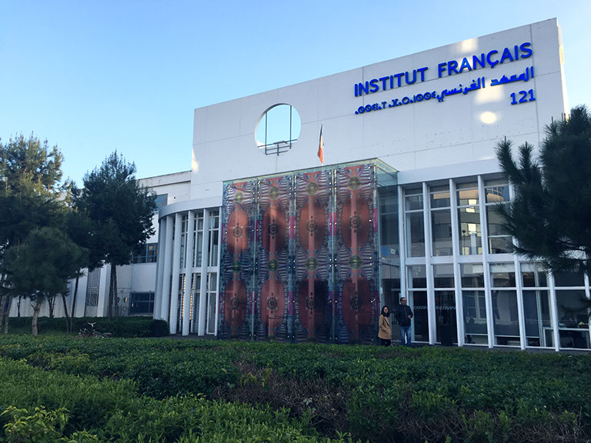
The French Institute

Slide 14
Institute Cervantes

Slide 15
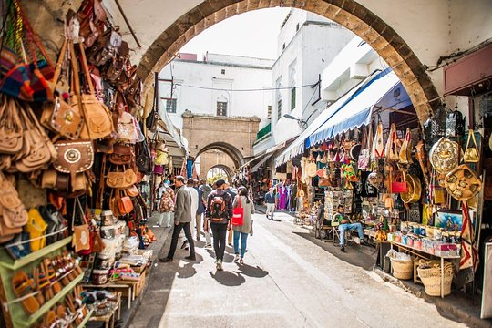
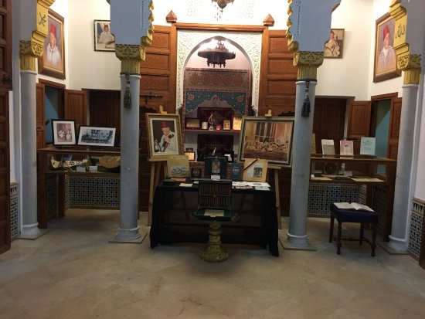
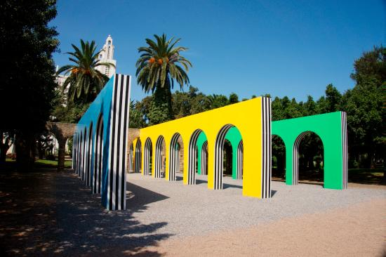
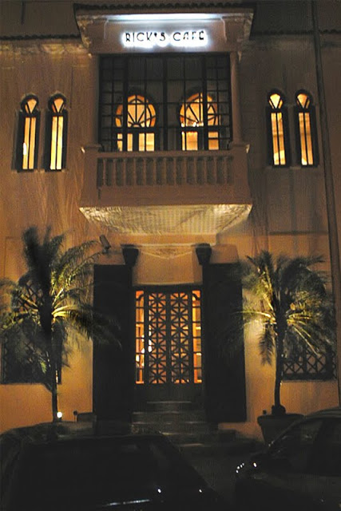
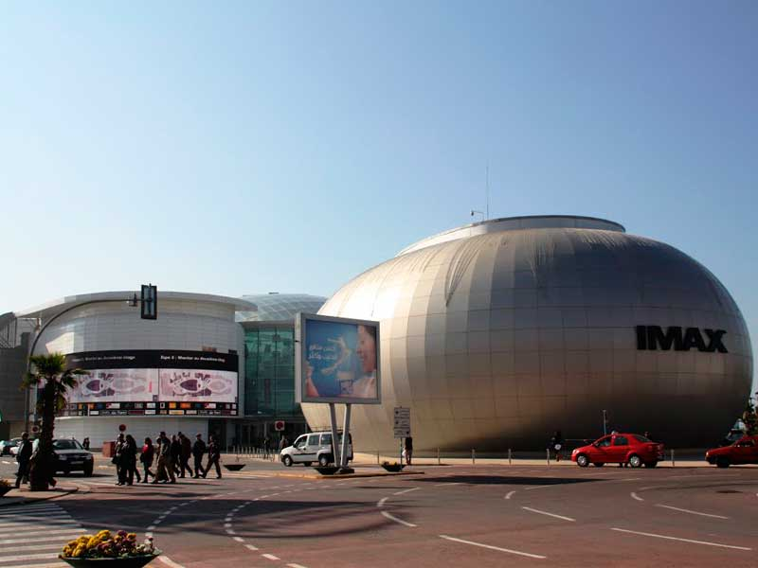
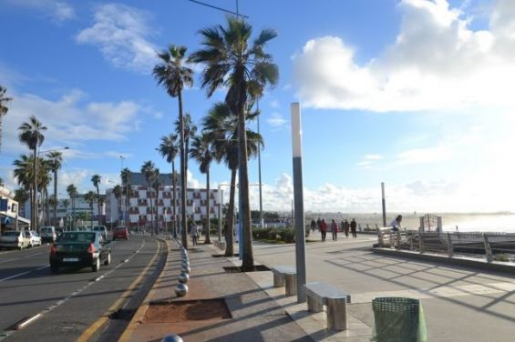
And much more !!

Slide 16
Transport
The city promotes mobility : in Casablanca, the tramway remains the most efficient mean of transport in the city, it allows a fast and secure way to reach both ends of the city avoiding traffic jams, In addition to a very dense network of taxis.

Slide 17
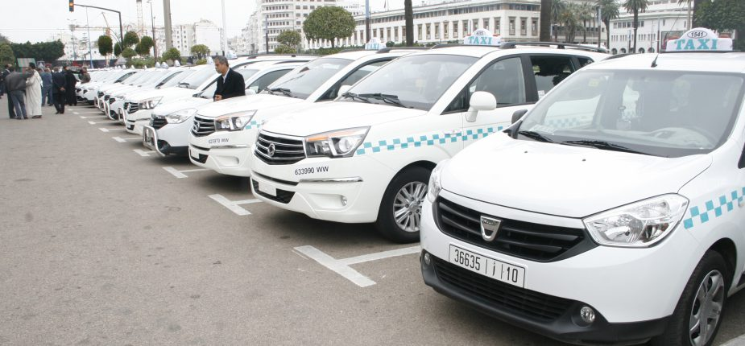
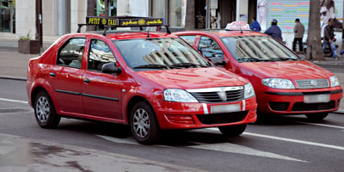
In the city
-Small taxis of red color: - Price in charge of starting 0,75 euros (= 7,50 dirhams) with the obligation to start the meter.
-Large white taxis: - Fixed fare - circulates in town or in long distance outside the city
-Apps : Heetch and Careem

Slide 18
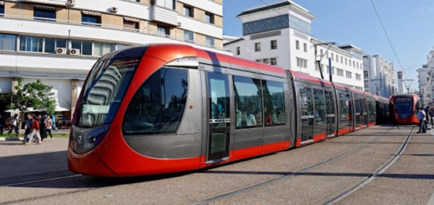
Tramway
- Tramway : 2 lines in Casablanca, line T1 and T2. The fare is 0,70 euros (= 7,00 dirhams).
Casa Tramway offers a monthly subscription for students. Illimited access for both lines for the price of 150dhs.
For further information the site http://www.casatramway.ma

Slide 19
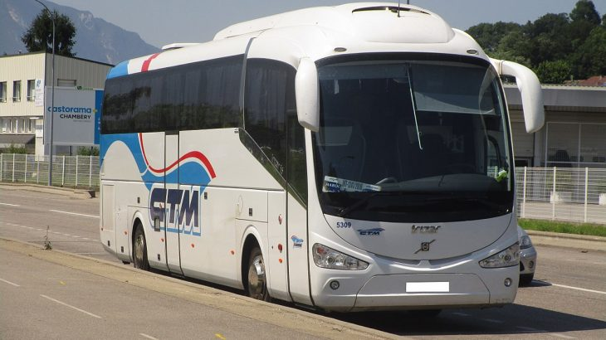
Out of the city
-CTM: Between comfort and an affordable price, the bus is a great way to get around Morocco. as if to go, for example to Marrakech. Return fare Casablanca-Marrakech 25,00 euros (= 250,00 dirhams) http://www.ctm.ma
-ONCF: The train is the fastest way of reaching two cities around the kingdom. For more information : https://www.oncf.ma

Slide 20
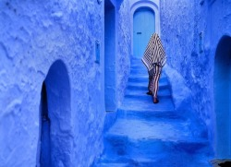
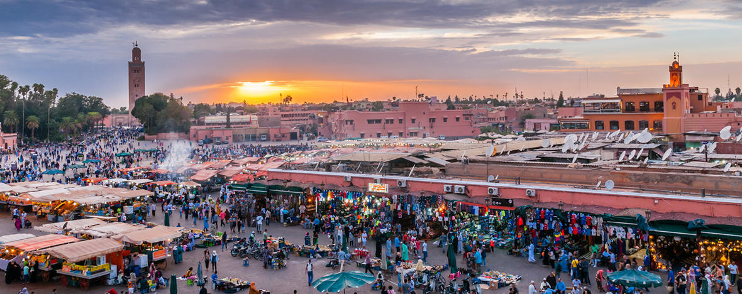
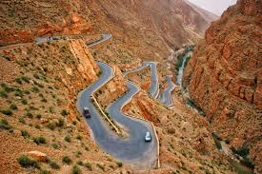
Discover Morocco !

Slide 21
Out of the country
-ONCF :And with the new TGV that links Casablanca to Tangier in only 2hrs 19,00 euros (= 190,00 dirhams), reaching a new country such as Spain, is accessible by ferry in only 35mins . https://www.oncf.ma

Slide 22
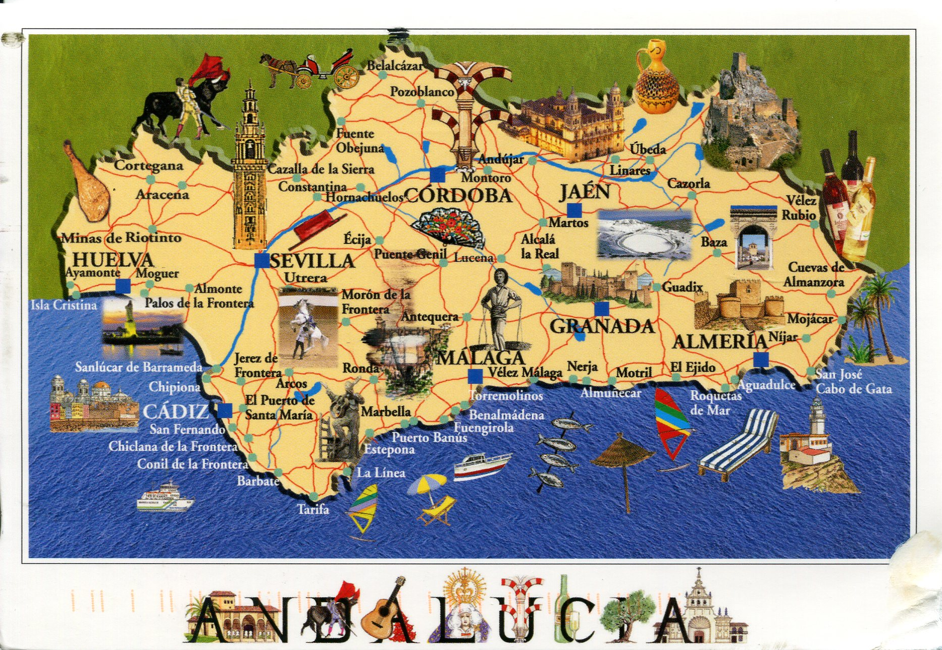
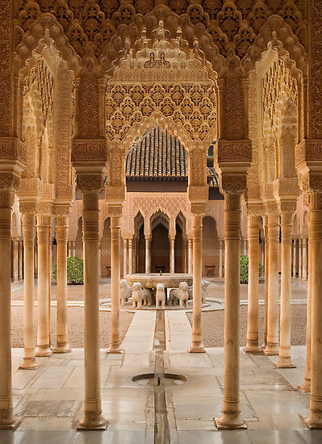
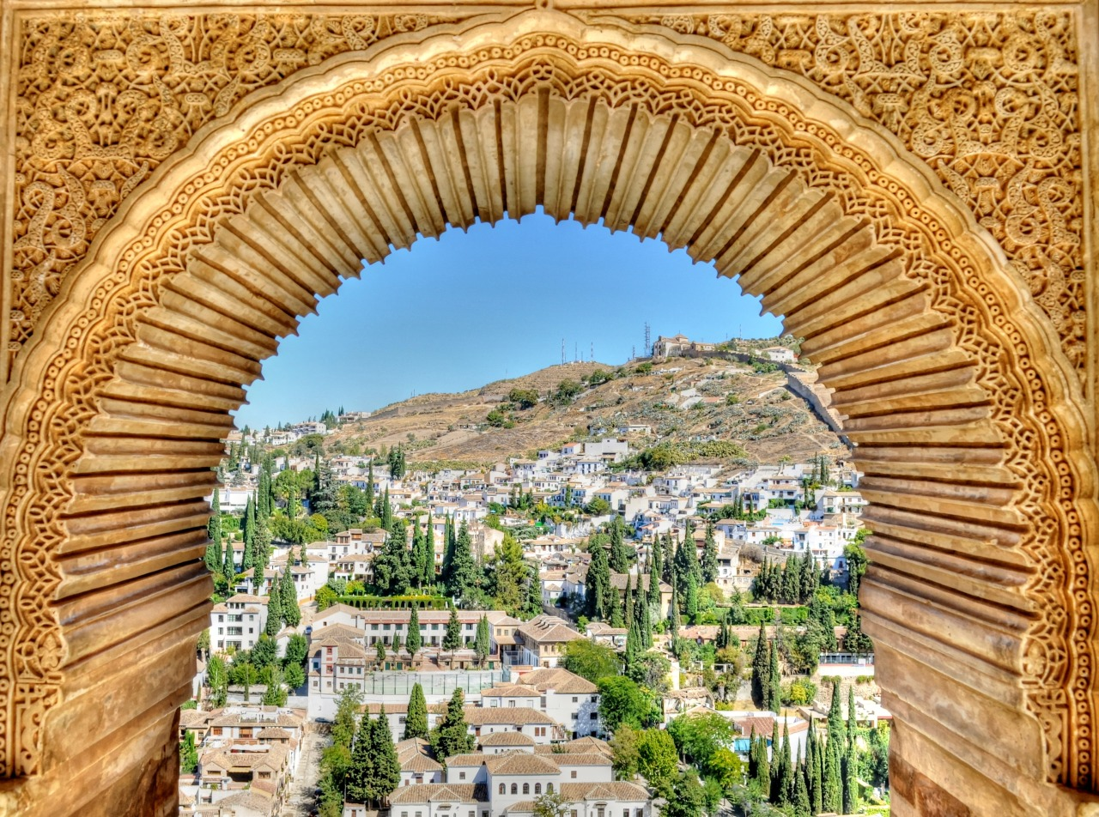
Visit Spain !

Slide 23
There are several types of housing : preferred student residences, apartments, rooms for rent Homestays or Airbnb.
Housing

Slide 24
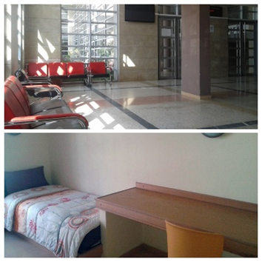
BAYT AL MAARIFA
-Student residence located 2.5 km from the campus of TBS accessible by Tramway in 10 minutes.
Housing offer : (+ pictures available on the site)
-Single room 190,00 euros / month (= 1900,00 dirhams).
-Twin room 130,00 euros / month (1300,00 dirhams).
A refundable deposit of 600,00 euros (= 6000,00 dirhams) will be requested upon delivery of keys.
http://www.baytalmaarifa.ma

Slide 25
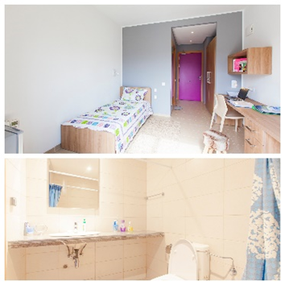
RESIDENCE ZIRAOUI
-Student residence located in a well-connected area, the university residence offers immediate access to all amenities and public transport. Campus access remaining a bit distant.
Housing offer : (+ pictures available on the site)
-Single room 250,00 euros/month (= 2500,00 dirhams).
-Twin room 170,00 euros/month (= 1700,00 dirhams).
http://www.resu.ma

Slide 26
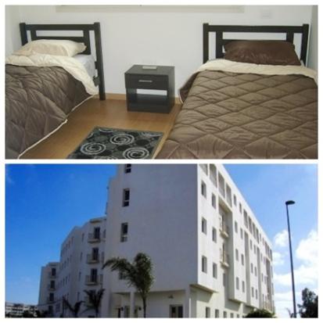
RESIDENCE DE L’OASIS
-Located in the residential area of the Oasis, accessible by tramway, 200 m from the Casa-Oasis train station, and at the intersection of higher education institutions.
Housing offer : (+ pictures available on the site).
-Single room payable quarterly 180,00 euros x3 months (= 1800,00 dirhams x 3 months).
-A refundable deposit of 180.00 euros (= 1800.00 dirhams) will be requested upon delivery of the keys.
http://www.loge-etudes.com/w3/

Slide 27
Apartements and studios
-Estimated rent in Casablanca varies by area and neighborhood. The average is 300,00 to 800,00 euros (3000,00 dirhams to 8000,00 dirhams) per month.
-Websites where to find rent http://logement.students.ma or http://avito.ma.

Slide 28
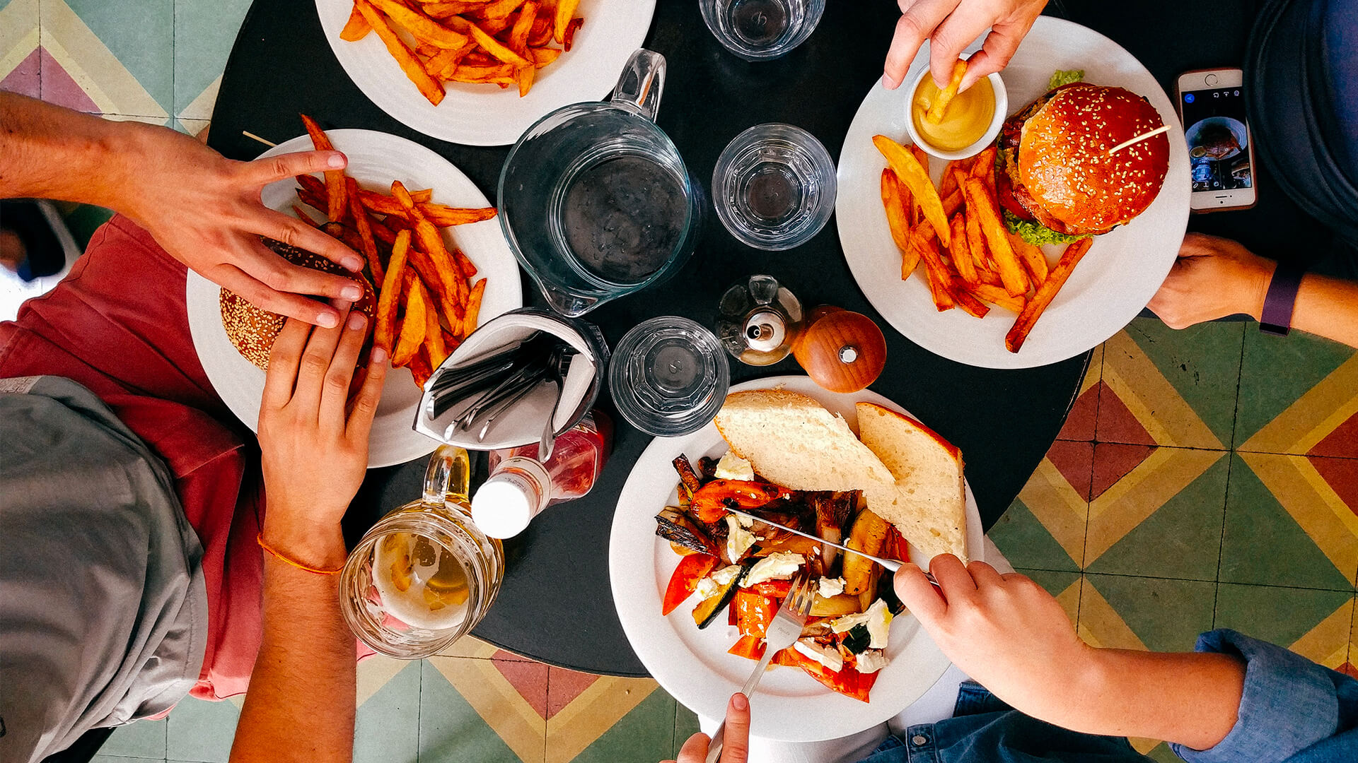
Everyday life

Slide 29
HYPERMARKETS AND SUPERMARKETS

Slide 30
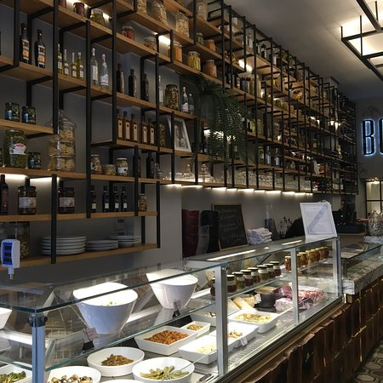
Small Shop & Delicatessen

Slide 31
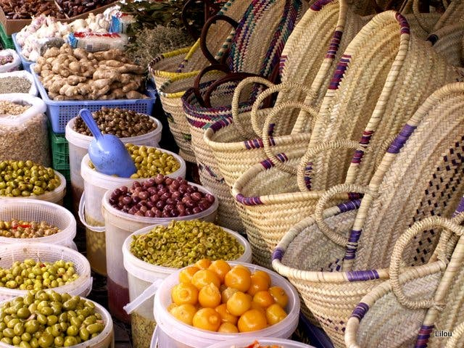
Souks : Maarif market & Central market

Slide 32
THE MAIN MOBILE TELEPHONE OPERATORS
Positive aspects of getting a Moroccan sim card :
Relatively available
Easy to use
Inexpensive (30dhs = 3euros)
Accesible data (credit starting from 5dhs available in shops)

Slide 33
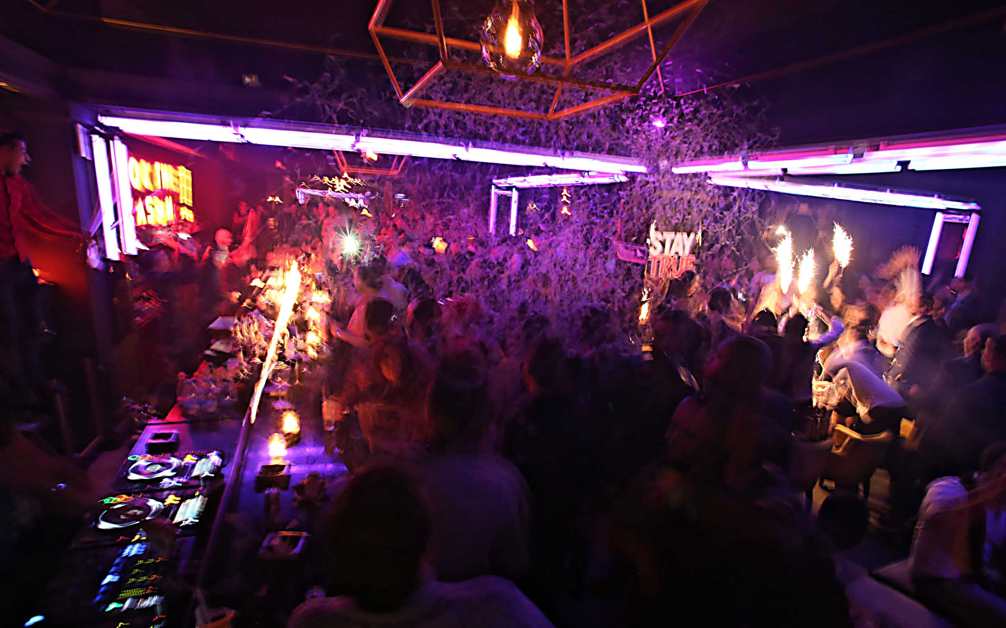
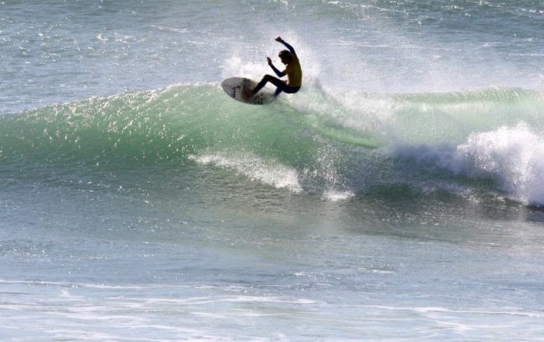
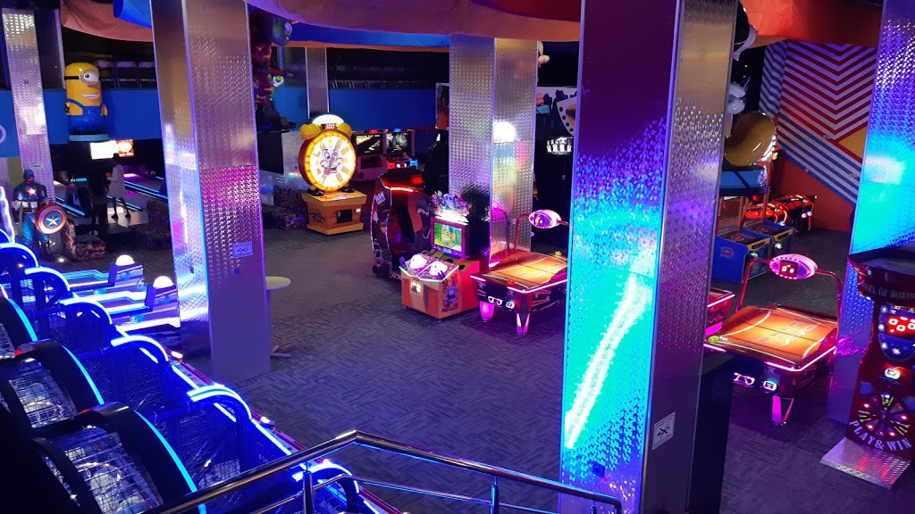
Enternainment

Slide 34
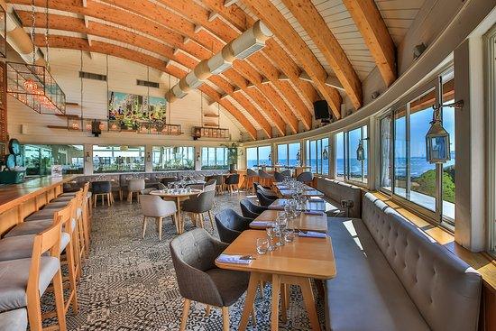
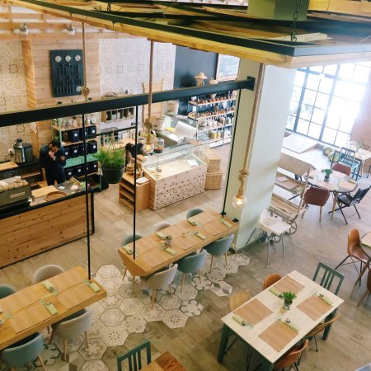
Restaurants

Slide 35
Food chains

Slide 36
Visa and Immigration
Upon your arrival, Toulouse Business School Casablanca will be in charge in your enrollement in Moroccan immigration.
You will need to provide us with documents that will allow us to garantie efficient release of your statue in Morocco.

Slide 37
Basic information

Slide 38
Basic information
Be aware of your surroundings, yourself and your possessions.
Respect others and the city by following the country’s rules (no drinking in public, dont disrespect the Monarchy or islam…)
Use Careem or Heetch at night to garantie a safe trip back home.
Make sure that the taxi driver has the meter on or agree on a fare before hand.
Western stomachs are usually ill-suited for unfiltered or tap water. The better option is to drink bottled water.
Moroccans generally frown upon revealing outfits. Do not show too much skin. Especially at night.
Do not enter mosques, the access is only limited to muslims, except for the Hassan ll Mosque.
Do not accept, purchase or consume drugs. Do not let it fool you that hashish and marijuana are widely consumed and available in Morocco. Penalties are still harsh and the Moroccan police do enforce the law.
Do not eat with the left hand, it is traditionnaly used for hygienic duties.
Upon your arrival in Morocco, tea will be proposed to you, it is polite to accept.
Take your shoes off when theres a rug.

Slide 39
What to do in case of emergency
Make sure you Inform the international Student Service of TBS Casablanca by Contacting Mrs Marie-Line Akhmiss throught m.akhmiss@tbs-education.ma or (06 66 63 36 43)
In case of life threatening injuries: Call the Fire department (150)
In case of a Medical Emergency : SOS Medecin at (05 22 82 81 81)
In case of Physical or Sexual Assault : Get yourself to a safe environment if possible, call the Police (190) or SOS Medecin (05 22 82 81 81)
In case of theft : Report the theft to the Police (190)
If any of these Incidents occur on campus, please make sure you alert the Administration and Security agent.

Slide 40
Emergency Numbers
Fire department 150
Police 190
Royal Gendarmerie 177
Information 160
Police airport +212 (0) 5 22 53 96 10
Institut Pasteur +212 (0) 5 22 27 57 78
SAMU Casablanca +212 (0) 5 22 98 98 98/ +212 (0) 5 22 25 25 25
SOS Doctor +212 (0) 5 22 20 20 20 +212 (0) 5 22 94 94 94
French Consulat in Casablanca +212 (0) 5 22 48 93 00
Spain Consulat in Casablanca +212 (0) 5 22 22 07 52

Slide 41
Health
You are studying outside of Europe.
If you study abroad, in a non-european country, your health protection varies according to your host country.
Your medical fees will be refunded by ‘la caisse d’Assurance Maladie’ according to the current french tarrif if you fill these conditions :
-You are a student in a school that will provide you with an official diploma. -You will have to be able to receive a school certificate
You will have to fill the application S3125
You will have to regulate your urgent medical fees on hand. In order to have them refunded, keep the bills and receipts of the payment and present them upon your return at your ‘Assurance Maladie’.

Slide 42
Application S3125

Slide 43
Semester S4 Time Table
Semaine | Du | Au | Informations
Mardi 7/01/2020 |  |  | Welcome & Orientation
1 | Mercredi 8/01/20 | vendredi 10/01/20 | Cours
2 | Lundi 13/01/20 | vendredi 17/01/20 | Cours
4 | Lundi 20/01/20 | vendredi 24/01/20 | Cours
5 | Lundi 27/01/20 | vendredi 31/01/20 | Cours
6 | Lundi 03/02/20 | vendredi 07/02/20 | Cours
7 | Lundi 10/02/20 | vendredi 14/02/20 | Cours
8 | Lundi 17/02/20 | vendredi 21/02/20 | Cours
9 | Lundi 24/02/20 | vendredi 28/02/20 | Cours & Séances de révisions
10 | Lundi 2/03/20 | vendredi 6/03/20 | Evaluations intermédiaires S4
11 | Lundi 9/03/20 | vendredi 13/03/20 | Vacances universitaires
12 | Lundi 16/03/20 | vendredi 20/03/20 | Vacances universitaires
13 | Lundi 23/03/20 | vendredi 27/03/20 | Cours
14 | Lundi 30/03/20 | vendredi 03/04/20 | Cours
15 | Lundi 6/04/20 | vendredi 10/04/20 | Cours
16 | Lundi 13/04/20 | vendredi 17/04/20 | Cours
17 | Lundi 20/04/20 | vendredi 24/04/20 | Révisions et examens S4

Slide 44
Question ?

Slide 45
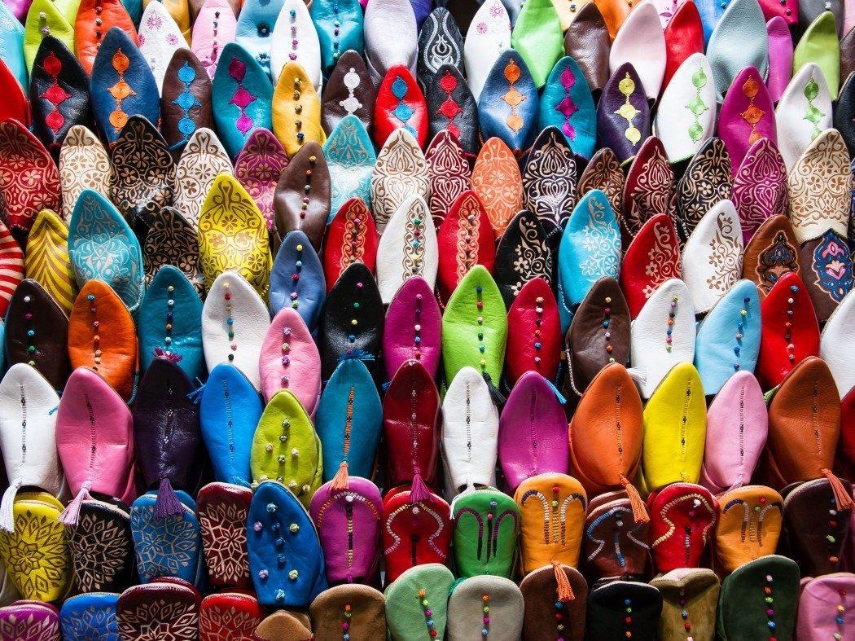
Thank you !

